Slide 1
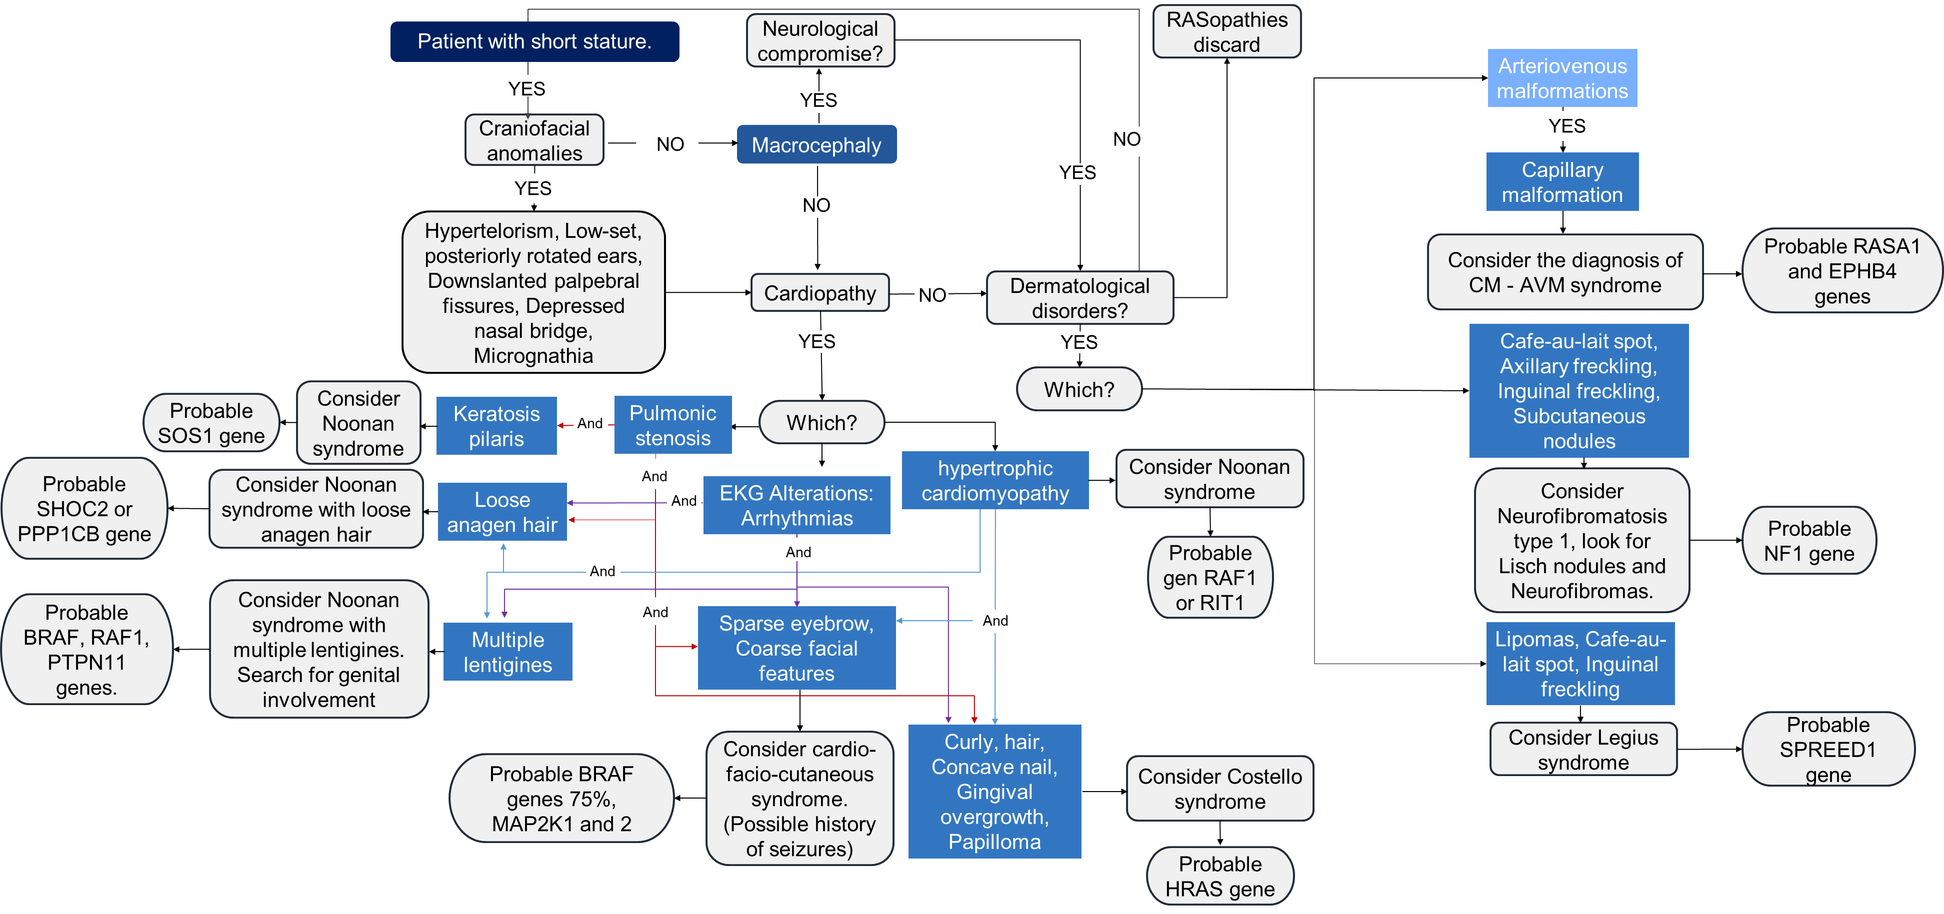
Proposal of an algorithm for the syndromic and molecular diagnosis of RASopathies based on HPO nomenclature.
Carlos Andres Quintero¹, Maria Fernanda Meneses¹, Diana Ramírez-Montaño², Harry Pachajoa³, Juliana Lores⁴
1. Faculty of Health Sciences, Universidad Icesi, Cali-Colombia
2. Department of Basic Medical Sciences, Faculty of Health Sciences, Universidad Icesi, Cali-Colombia. Center for Research in Congenital Anomalies and Rare Diseases (CIACER). Universidad Icesi, Cali - Colombia.
3. Department of Genetics, Fundación Valle del Lili, Cali - Colombia. Center for Research in Congenital Anomalies and Rare Diseases (CIACER). Universidad Icesi, Cali - Colombia.
4. Medical Genetics Program, Faculty of Health Sciences, Universidad Icesi, Cali - Colombia.
Introduction:
patterns were integrated into a diagnostic algorithm (Figure 1) that is capable of suggesting a clinical and molecular diagnostic impression for the patients. This is linked to a population-based registry database of patients with clinically suspected and confirmed molecular diagnosis of RASopathies; this project is currently under development; it is planned to validate the functionality and diagnostic capability of the algorithm in the patients of the aforementioned registry
RASopathies are a heterogeneous set of genetic syndromes caused by germline mutations in genes encoding components or regulators of the RAS/mitogen-activated protein kinase (MAPK) pathway; each RASopathy expresses a characteristic phenotypic pattern; however, common mechanisms of Ras/MAPK pathway dysregulation result in overlapping clinical manifestations. Currently, only clinical criteria are available for the diagnostic approach of Neurofibromatosis 1 and Noonan syndrome; while other rasopathies lack a clinical standard for their diagnosis, in addition to this exists limited skill in identifying typical phenotypes by health personnel, which hinders the timely diagnosis of these syndromes; due to this, we proposed the elaboration of an algorithm for the syndromic and molecular diagnostic approach in patients with suspected RASopathies based on the clinical phenotypic characteristics found in the literature with the Human Phenotype Ontology HPO tool.
Expected results:
It is expected that by submitting the algorithm to the validity test using the patients present in the database, data will be obtained that will allow us to know the intrinsic and extrinsic characteristics of the diagnostic algorithm (sensitivity, specificity, positive predictive value, negative predictive value, etc).
Methods:
Conclusions:
A search was performed in the literature and in the HPO library of the phenotypic findings for each of the RASopathies. It was determined that the algorithm should include short stature as a common characteristic due to its high frequency among the syndromes that present the greatest challenge in clinical diagnosis, In addition, the phenotypic findings were classified according to a systemic approach that included elements of dermatology, cardiology, urology, among others, with which high frequency phenotypic patterns were designed for each of the main syndromes within the RASopathies and in selected cases high frequency phenotypic patterns were designed for mutations in specific genes within the syndromes; These phenotypic
At the moment no similar research has been published that seeks to establish a methodical and standardized approach for the clinical and molecular diagnosis of RASopathies based on clinical findings, it is expected that the results obtained will allow us to reach the conclusion to recommend/reject the clinical and molecular diagnostic algorithm presented.
The limitations of this research include the limited number of patients for certain syndromes (cardio-facial-cutaneous syndrome, Legius syndrome and Costello syndrome) and the absence of a detailed analysis of the publication bias present in the study.
Figure 1. Diagnostic algorithm
References
Rauen KA. The RASopathies. Annu Rev Genomics Hum Genet. 2013;14:355-69.
Hernández-Martín A, Torrelo A. Rasopatías: trastornos del desarrollo con predisposición al cáncer y manifestaciones cutáneas. Actas Dermo-Sifiliográficas [Internet]. julio de 2011 [citado 9 de diciembre de 2020];102(6):402-16. Disponible en: https://linkinghub.elsevier.com/retrieve/pii/S000173101100113X

